Slide 1
4-Step Learning System: TAIWANESE
(Description )

Slide 2
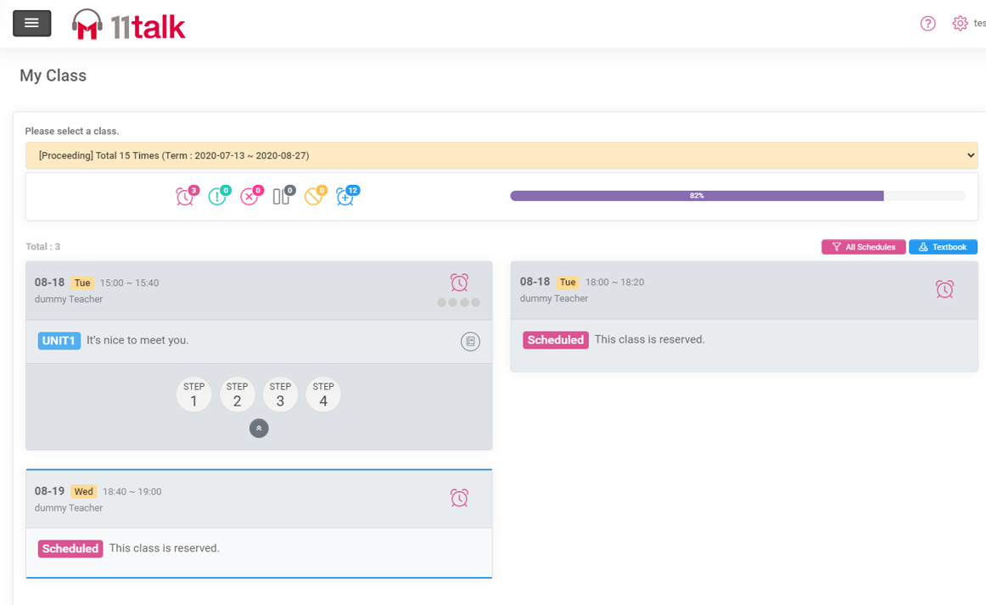

Systematic and Effective Learning Method
高效的線上課學習系統
11talk's 4-step learning method has created great results in improving students' English macro skills from listening, writing, and reading, and speaking.
11talk的四步學習方法在提高學生的聽、說、讀、寫的四個英語全方面能力並取得顯著成績

Slide 3
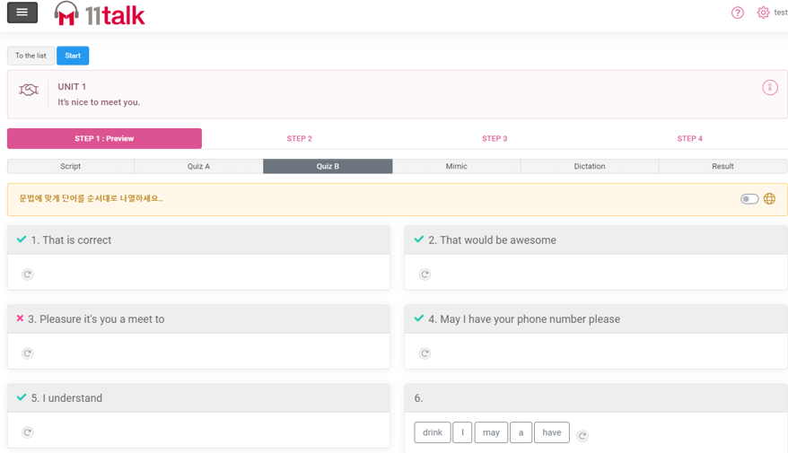
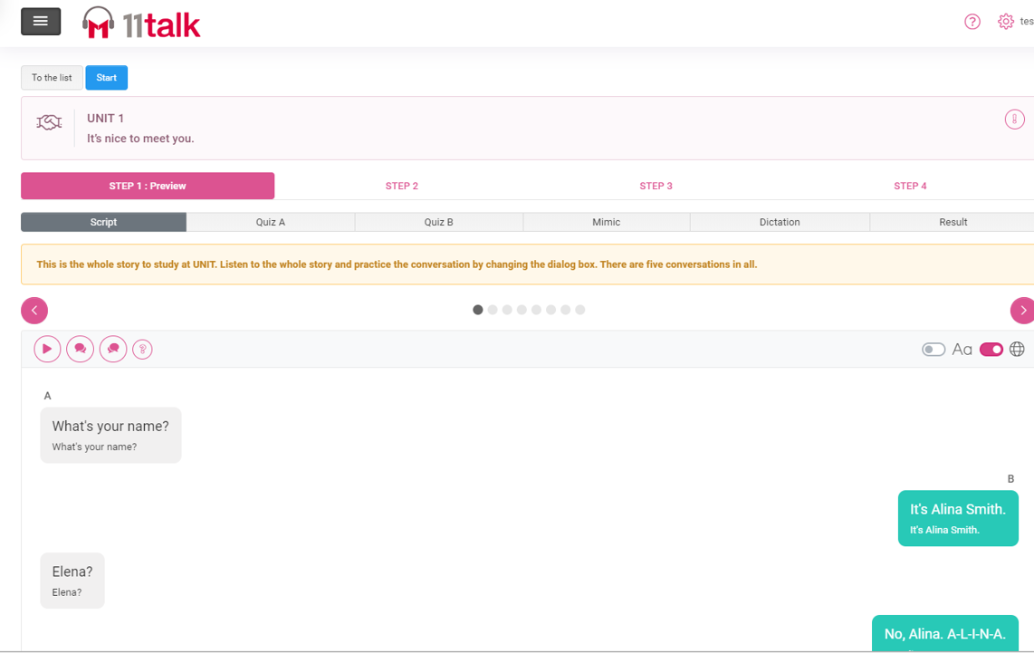
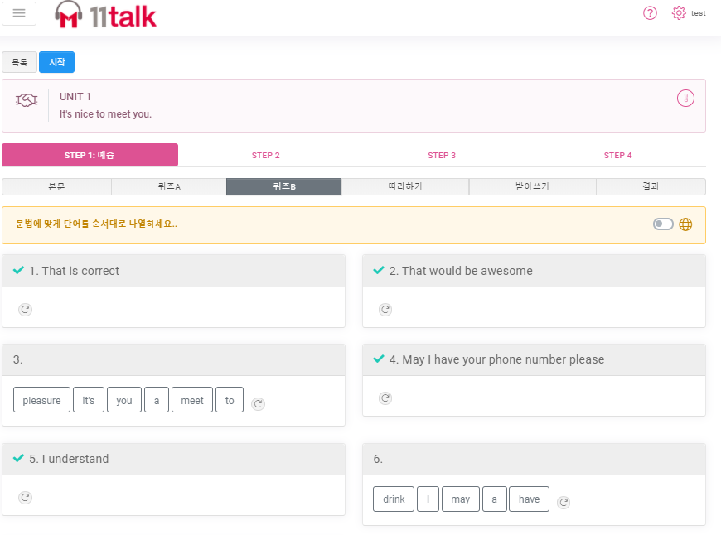
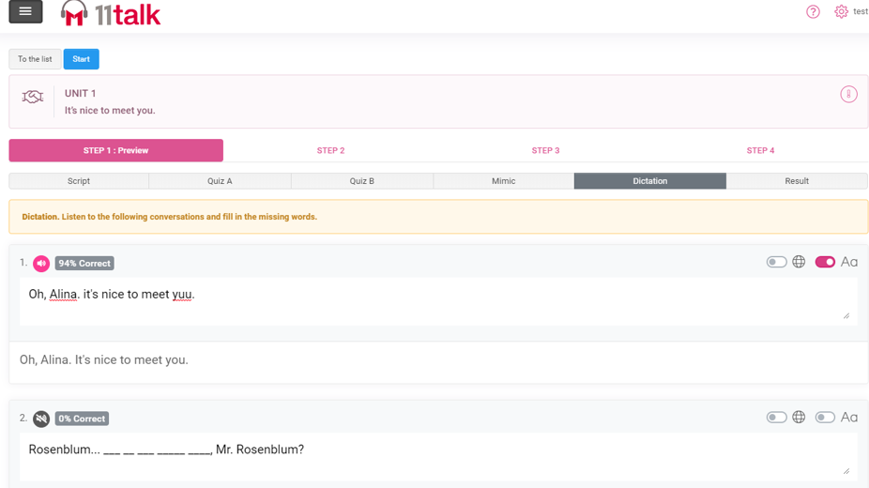

Step 1(Preview): Learn vocabulary and expressions before the class through initial quizzes, English audio files, and follow-up conversations.
步驟1（預習）：在上課之前，通過初步測驗，英語錄音檔等文件和後續對話來學習詞彙和表達方式。
您可以通過聽錄音檔開始為即將上課的課程練習新的表達方式和單詞
參加測驗A，並配對將完成句子的正確單詞/片語
You may start practicing the new expression and words for your incoming lesson by listening to the audio script.
Take Quiz A and match the right word / phrase that will complete the sentence
記住新的表達方式
通過參加測驗B並重新排列單詞
模仿是最好的英語學習方式之一。通過模仿具有適當發音的錄音檔，您將更容易記住單詞和表達方式
Remember the new expressions
by taking quiz B and re-arranging the words
One of the best ways of English Learning is mimicking. it will be easier for you to remember the words and expressions by mimicking audio script with proper pronunciation

Slide 4
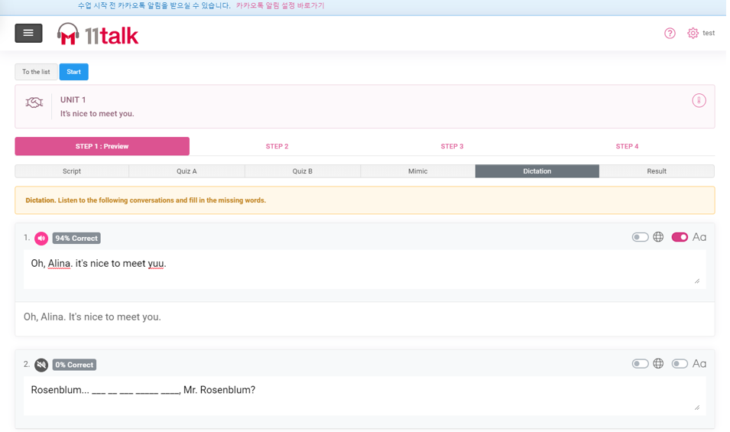
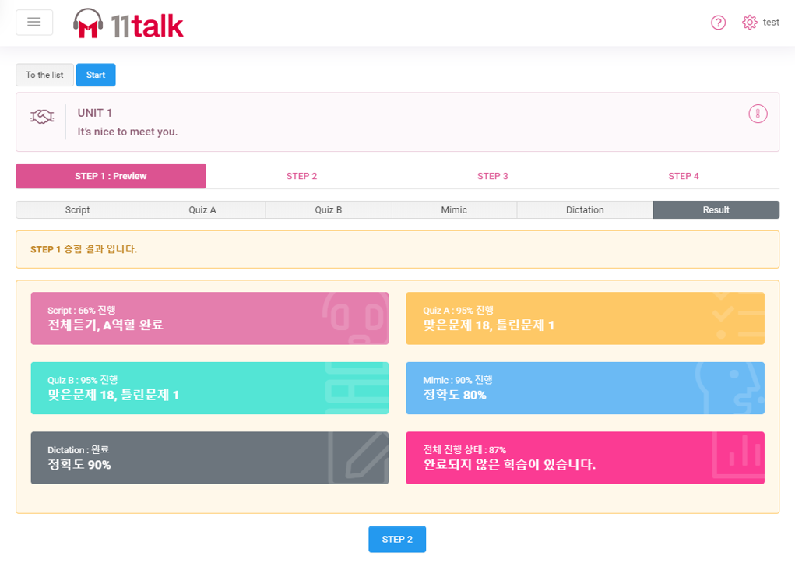

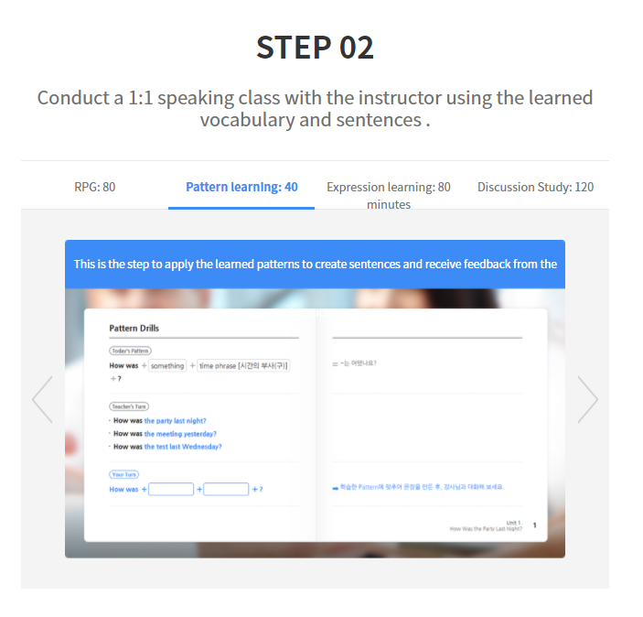
查看你在課程預覽中錯過的事情，並確保記住本單元中的新單詞和新表達
通過聽寫練習，學習效果會更好
retention is more effecti by answering the dictation exercise.
Check the things you have missed from your lesson preview and make sure to remember the new words and expressions from the unit

Slide 5
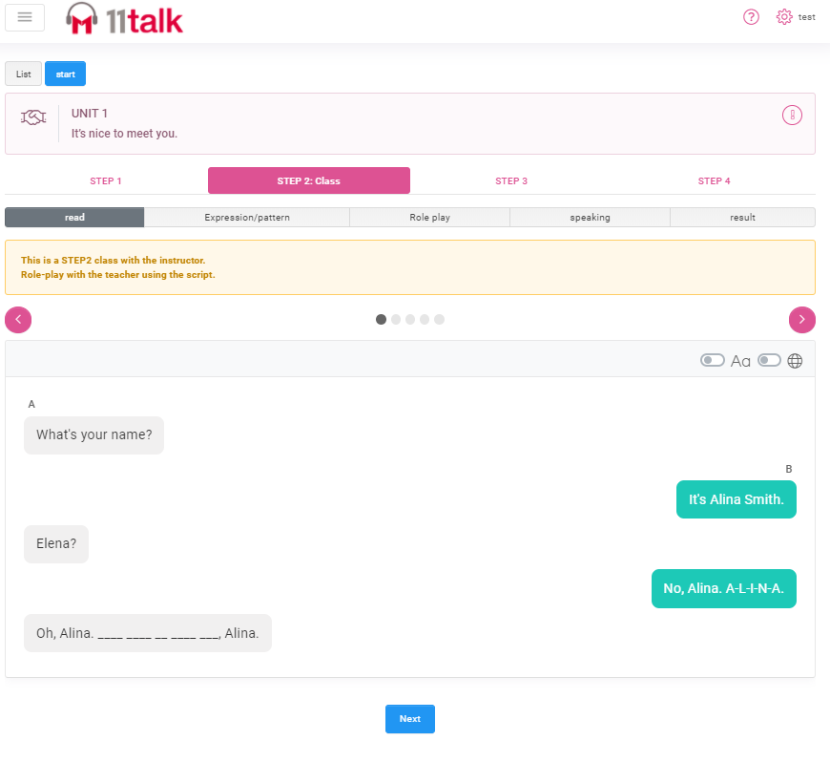
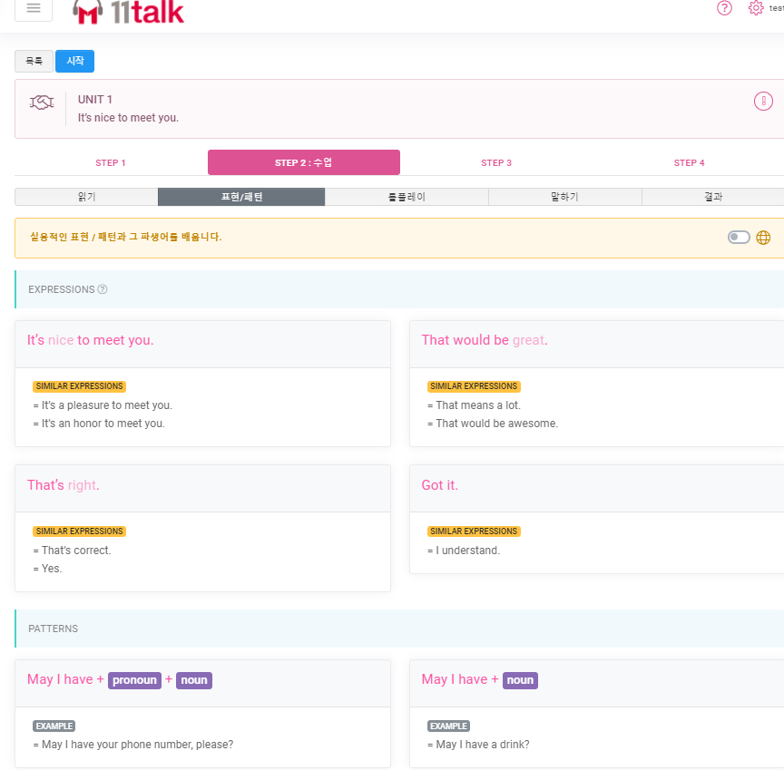
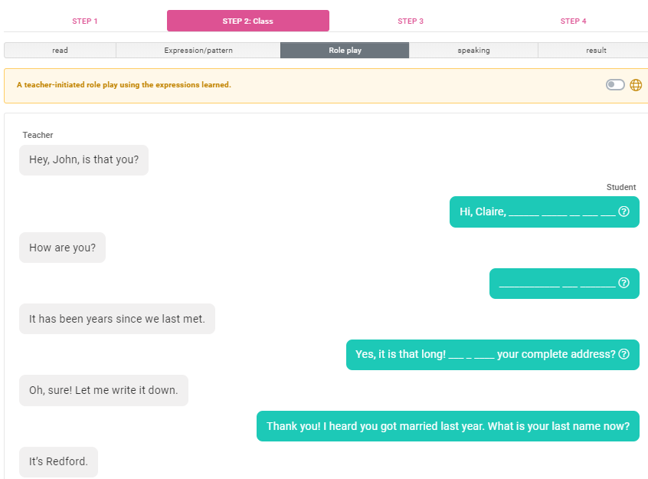


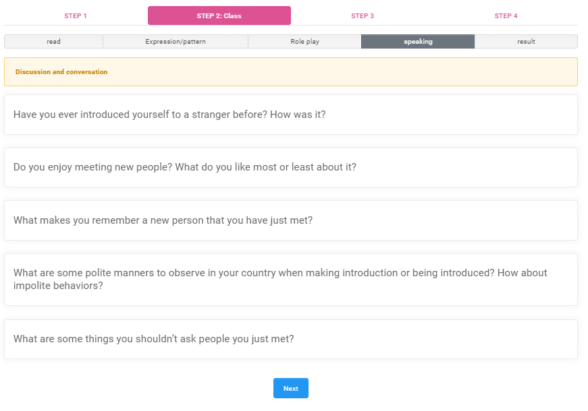
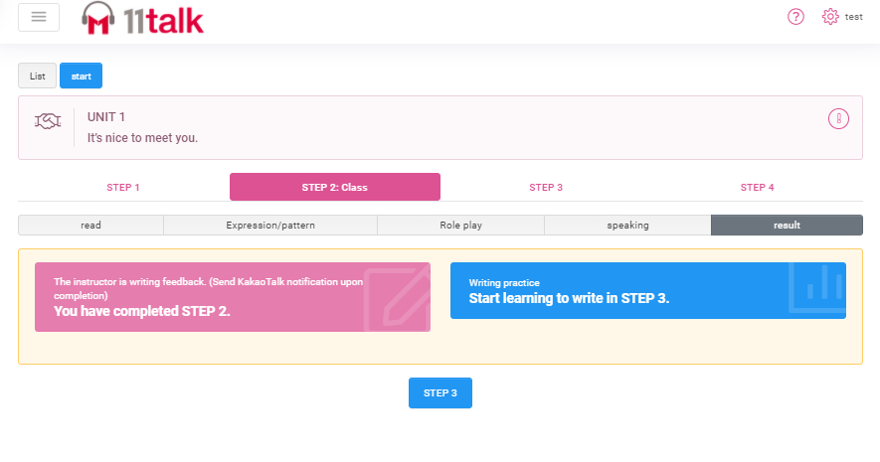

第2步（與您的老師一對一上課）：與您的線上英語老師一起在課堂上使用所學到的單詞和表達式
Practice accent and pronunciation with your 1:1 Teacher by reading the lesson script.
Learn practical expressions/patterns and similar expressions for everyday use
通過對話練習的部分與老師進行互動
通過閱讀課程，與1：1老師練習口音和發音
學習日常使用的實用表達式/模式和類似表達式
Engage in activity with your teacher through the role play section
通過在課本中使用所學到的知識來加以強化記憶
通過使用實用的表達方式來回答老師的問題，以達到流利使用的程度
Seal in what you have learned by using it on your written output.
Gain fluency by using the practical expressions and patterns in answering your teacher’s questions.

Slide 6
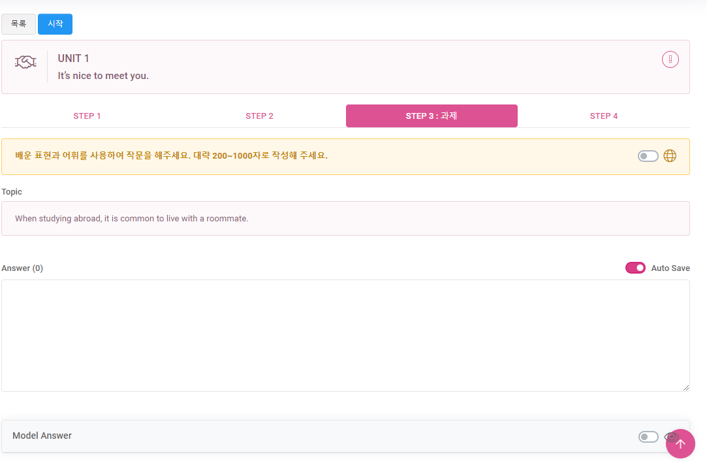
步驟3（作業）：通過完成作業，並從中使用學到的表達方式和詞彙量，讓自己多做些練習

Slide 7
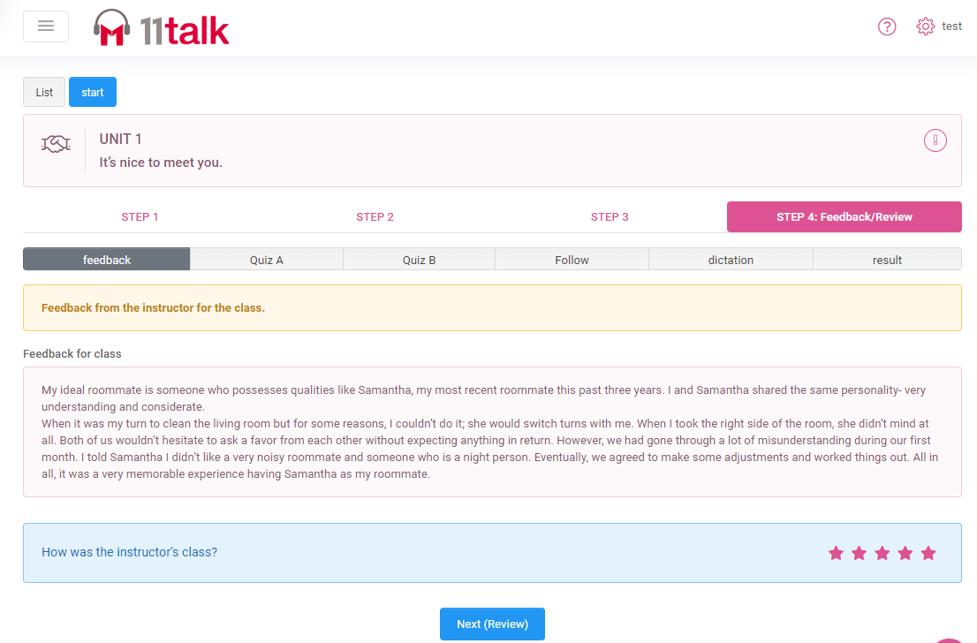
第4步（課後複習）：關看您的每日課堂反饋，並複習老師的評論和建議。再次作答A和B的測驗，模仿聽寫練習，然後看看您錯過了什麼。

